Slide 1
The Air Marshalls

Slide 2
Project outline
The project will analyze the flights’ delays, cancellations and other statuses in the US for 322 different airlines. The dataset contains just above 5 million records with 31 columns.
We will present to you the findings that “Multico-Air” requested as a part of the scope, for them to able to have a detailed analysis on flight delays in the industry, to identify a niche solution between the competitors.
Required: GM, board of directors, aviation team, senior pilot executive Amro and airport operation manager Amritya.

Slide 3
Data Source:
Free Data Sets & Dataset Samples | Maven Analytics – Airline Flight Delays (2015 data)
Jupyter Notebook
Pie chart
Whisker box
Line chart
Scatter plot
Bar chart
Informative map
Power BI
Tools and graphs:
Pandas
Numpy
OS
Seaborn
Matplotlib.PyPlot
Scipy.stats
Requests
Gmaps
Libraries:

Slide 4
Detailed analysis breakdown
How does the overall flight volume vary by month in 2015?
What percentage of flights experienced a departure delay in 2015? Among those flights, what was the average delay time, in minutes?
How does the delayed flights % vary throughout the year (monthly)?
What are the top 5 busiest origin airports in 2015? And what are the top 5 origin airports with the highest departure and arrival delays?
How many flights were cancelled every month for the top 5 origin airports?
How many flights were cancelled in 2015? What % of cancellations were due to weather? What % were due to the Airline/Carrier fault?
Which airlines seem to be most and least reliable, in terms of on-time departure in 2015?
Which airlines on average depart before the set schedule in 2015?
How does the distance of a trip have an influence (if any) on the arrival/departure delay of a flight?

Slide 5
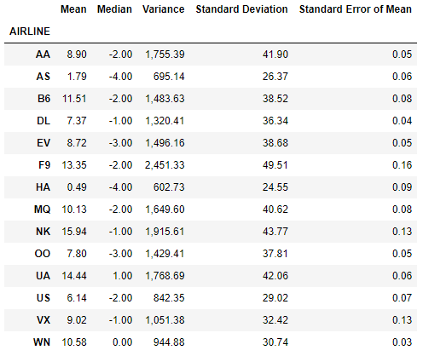
Initial Overview

Slide 6
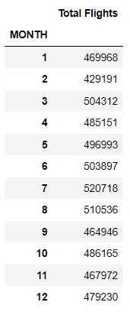
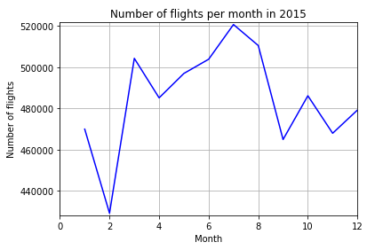
How does the overall flight volume vary by month in 2015?

Slide 7
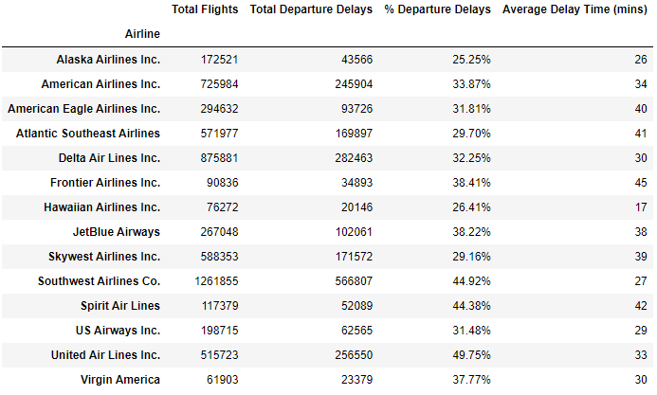
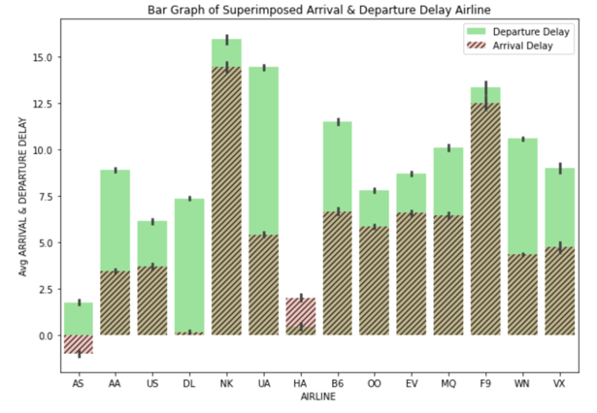
What percentage of flights experienced a departure delay in 2015?
Among those flights, what was the average delay time, in minutes?

Slide 8
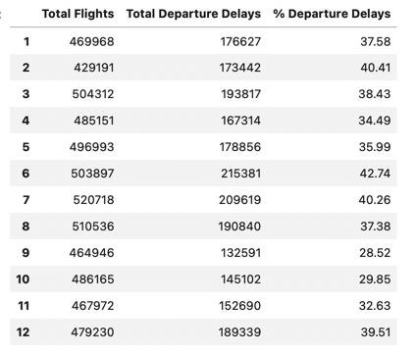
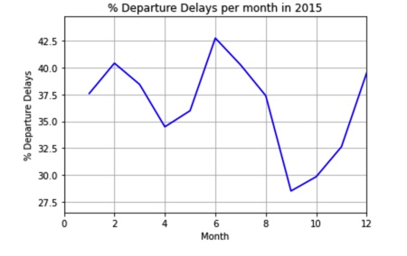
How does the delayed flights % vary throughout the year (monthly)?

Slide 9
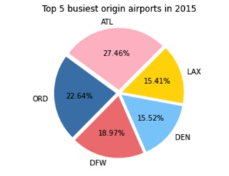
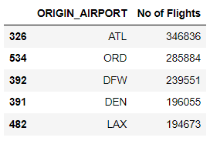
What are the top 5 busiest origin airports in 2015?

Slide 10
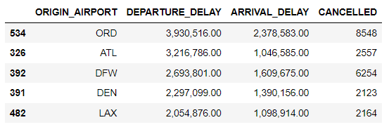
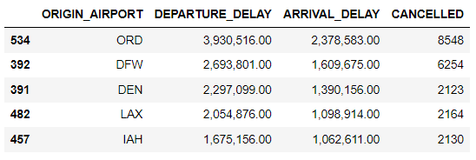
What are the top 5 origin airports with the highest departure and arrival delays?

Slide 11
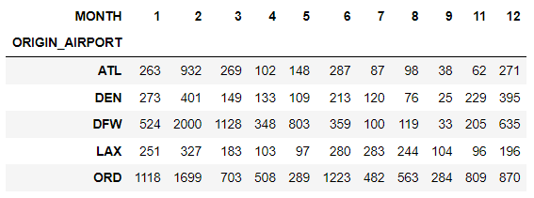
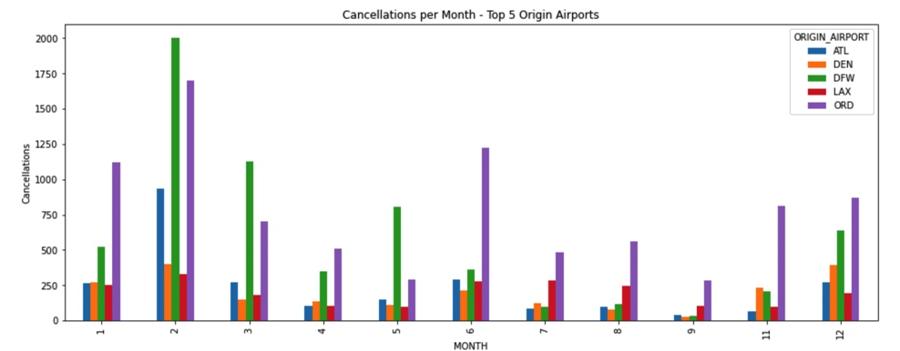
How many flights were cancelled every month for the top 5 origin airports?

Slide 12
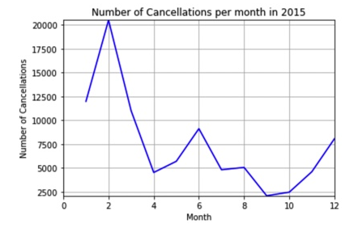
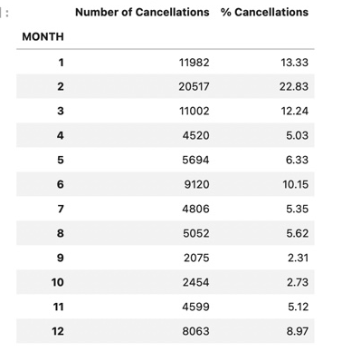
How many flights were cancelled in 2015?

Slide 13
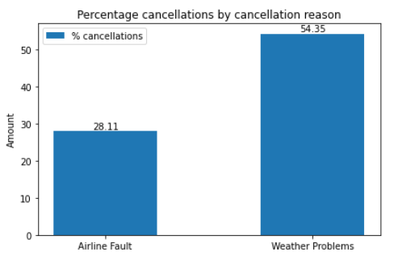
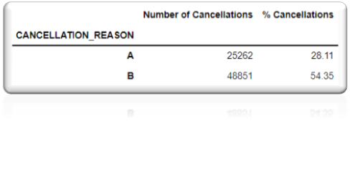
What % of cancellations were due to weather? What % were due to the Airline/Carrier fault?

Slide 14
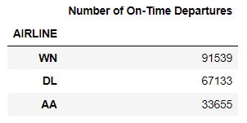
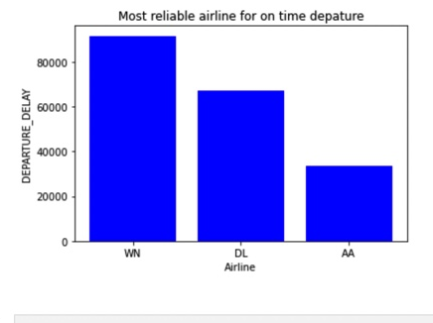
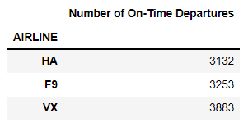
Which airlines seem to be most and least reliable, in terms of on-time departure in 2015?

Slide 15
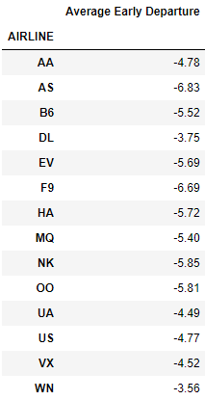
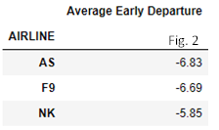
Which airlines on average depart before the set schedule in 2015?

Slide 16
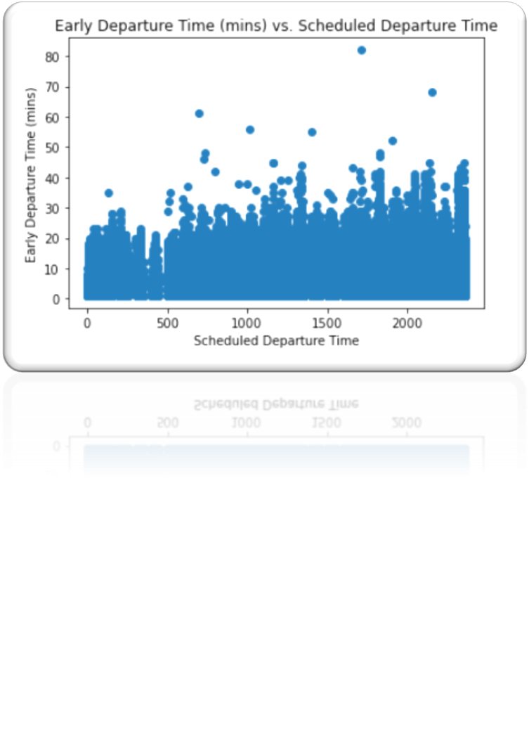
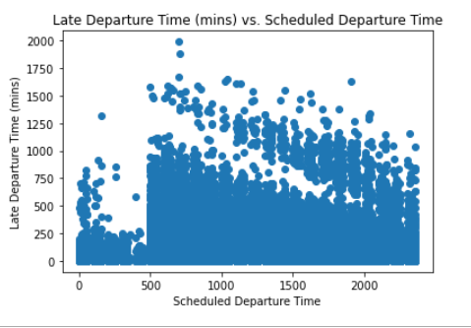

Slide 17
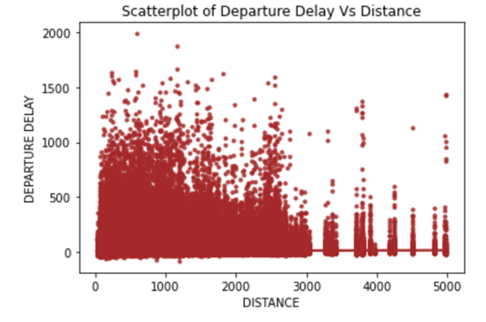
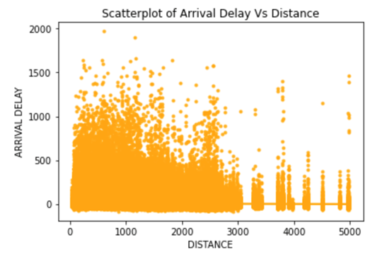
How does the distance of a trip have an influence (if any) on the arrival/departure delay of a flight?

Slide 18
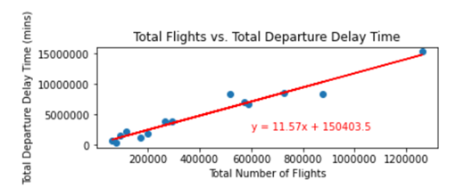
Hypothesis Testing

Slide 19
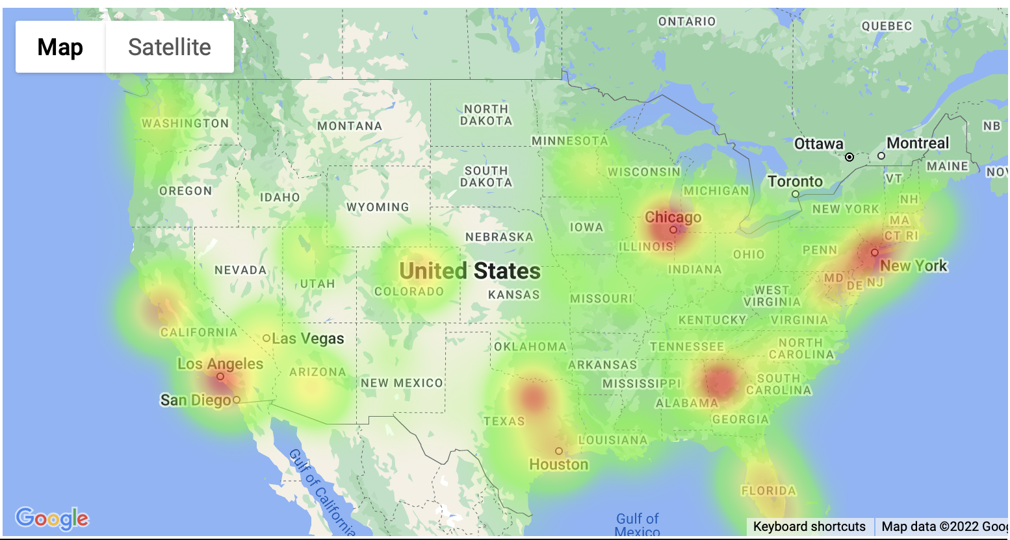
Heat map

Slide 20
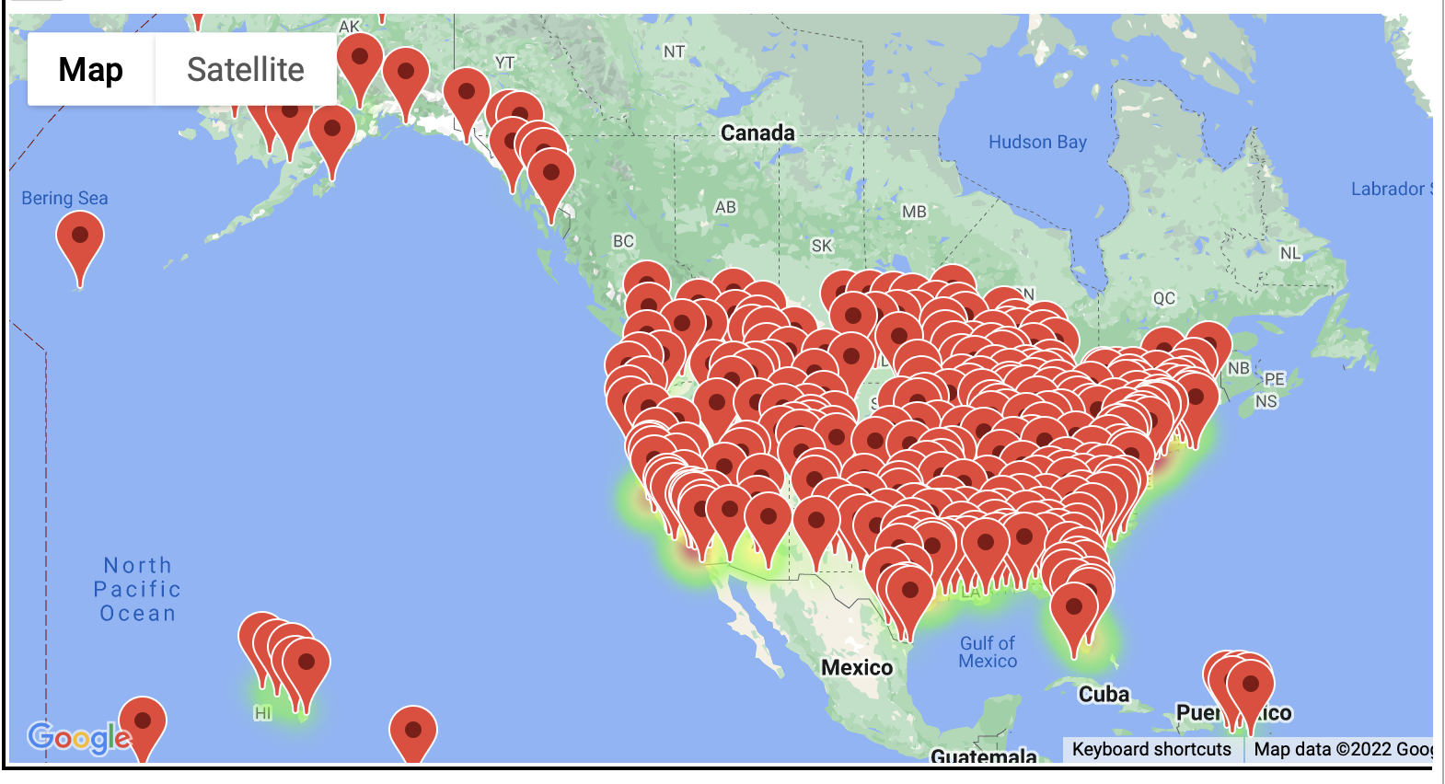
Airport map

Slide 21
Recommendations
Controlling number of flights offered
Professional aviation team for air control
Higher number of runways at Multico Air’s airports of choosing
Focus package deals on low-peak seasons
Airline Operations study for in depth information on day to day operation in the month of September as it has the lowest percentage of departure delays, to learn how to keep it low throughout the year.

